Slide 1
Distributed Systems Clusters, Grids, Clouds, Future Internet
P434 Fall 2014
Lecture 5
Judy Qiu
http://salsahpc.indiana.edu
School of Informatics and Computing
Indiana University

Slide 2
Outline
Performance Model
Parallel Patterns

Slide 3
Numbers that Everybody Should Know
L1 cache reference | 0.5 ns
Branch mispredict | 5 ns
L2 cache reference | 7 ns
Mutex lock/unlock | 25 ns
Main memory reference | 100 ns
Compress 1K w/cheap compression algorithm | 3,000 ns
Send 2K bytes over 1 Gbps network | 20,000 ns
Read 1 MB sequentially from memory | 250,000 ns
Round trip within same datacenter | 500,000 ns
Disk seek | 10,000,000 ns
Read 1 MB sequentially from disk | 20,000,000 ns
Send packet CA->Netherlands->CA | 150,000,000 ns
Google

Slide 4
What can we learn from performance observations?
We implemented the algorithm on parallel computer X and achieved a speedup of 10.8 on P=12 processors with problem size N=100 .
What happens on 1000 processors? What if N=10 or N=1000? What if communication costs are ten times higher?
Answering these questions requires a deeper understanding of the parallel algorithm.

Slide 5
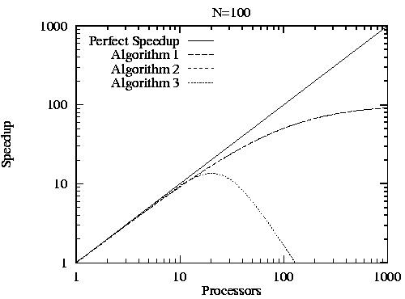
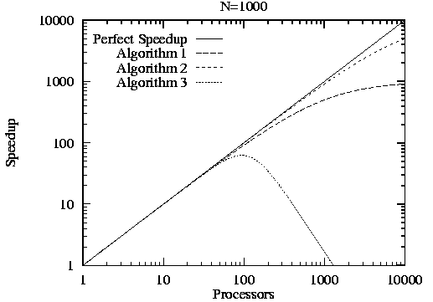
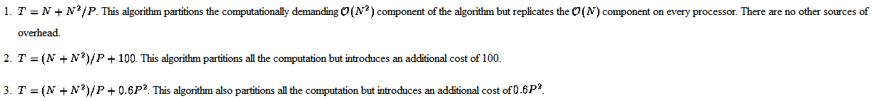
Asymptotic Analysis
Ian Foster

Slide 6
Performance Laws, Analysis and Modeling
The LogP Model
° Processing
– powerful microprocessor, large DRAM, cache => P
° Communication
+ significant latency (100's –1000’s of cycles) => L
+ limited bandwidth (1 – 5% of memory bw) => g
+ significant overhead (10's – 100's of cycles) => o
- on both ends
– no consensus on topology
=> should not exploit structure
+ limited network capacity
– no consensus on programming model
=> should not enforce one
K. Yelick

Slide 7
LogP
P ( processors )
P
M
P
M
P
M
° ° °
o (overhead)
o
g (gap)
L (latency)
Limited Volume
Interconnection Network
(
L/ g
to or from
a proc)
Latency in sending a (small) message between modules
overhead felt by the processor on sending or receiving msg
gap between successive sends or receives (1/BW)
Processors
α
β
K. Yelick

Slide 8
Using the LogP Model
o
L
o
o
L
o
g
time
Send n messages from proc to proc in time
2o + L + g (n-1)
each processor does o*n cycles of overhead
has (g-o)(n-1) + L available compute cycles
Send n total messages from one to many
in same time
Send n messages from many to one
in same time
all but L/g processors block so fewer available cycles, unless scheduled carefully
P
P
K. Yelick
Notes:
g > o by construction

Slide 9
Common Parallel Patterns
Embarrassingly Parallel
Replicable
Repository
Divide & Conquer
Pipeline
Recursive Data
Geometric
Irregular Mesh
Inseparable
E. Kim

Slide 10
Embarrassingly Parallel
Problem: Need to perform same operations on tasks that are independent
manager
A
B
C
D
E
Independent Tasks
A
B
C
D
E
worker
worker
worker
worker
E. Kim

Slide 11
Replicable
Sets of operations need to be performed using global data structure, causing dependency.
Global Data
replicate
local
local
local
Operation I
Operation II
Operation III
reduce
Solution
E. Kim

Slide 12
Repository
Independent computations need to apply to centralized data structures in a
non-deterministic way.
Compute E
Compute A
Compute D
repository
Asynchronous
Function calls
Compute B
Compute C
Compute object cannot access
same element simultaneously.
(Repository controls access)
E. Kim

Slide 13
Divide & Conquer
A problem is structured to be solved in sub-problems independently, merging them later.
problem
subproblem
split*
subproblem
split
split
Compute
subproblem
Compute
subproblem
Compute
subproblem
Compute
subproblem
merge
merge
subproblem
subproblem
merge
solution
* Split level needs to be adjusted appropriately.
E. Kim

Slide 14
Pipeline
A series of ordered but independent computation stages need to be applied on data,
where each output of a computation becomes input of subsequent computation.
Time
Stage 1
C1
C2
C3
C4
C5
C6
Stage 2
C1
C2
C3
C4
C5
C6
Stage 3
C1
C2
C3
C4
C5
C6
Stage 4
C1
C2
C3
C4
C5
C6
E. Kim

Slide 15
Recursive Data
Recursive data structures seem to have little exploitable concurrency.
But in some cases, the structure can be transformed.
4
3
Find Root Problem
2
4
1
6
3
5
7
2
4
Step 1
1
6
3
5
7
2
Step 2
1
6
5
7
Step 3
E. Kim

Slide 16
Geometric
Dependencies exist, but communicate in predictable
(geometric) neighbor-to-neighbor paths.
Neighbor-To-Neighbor communication
E. Kim

Slide 17
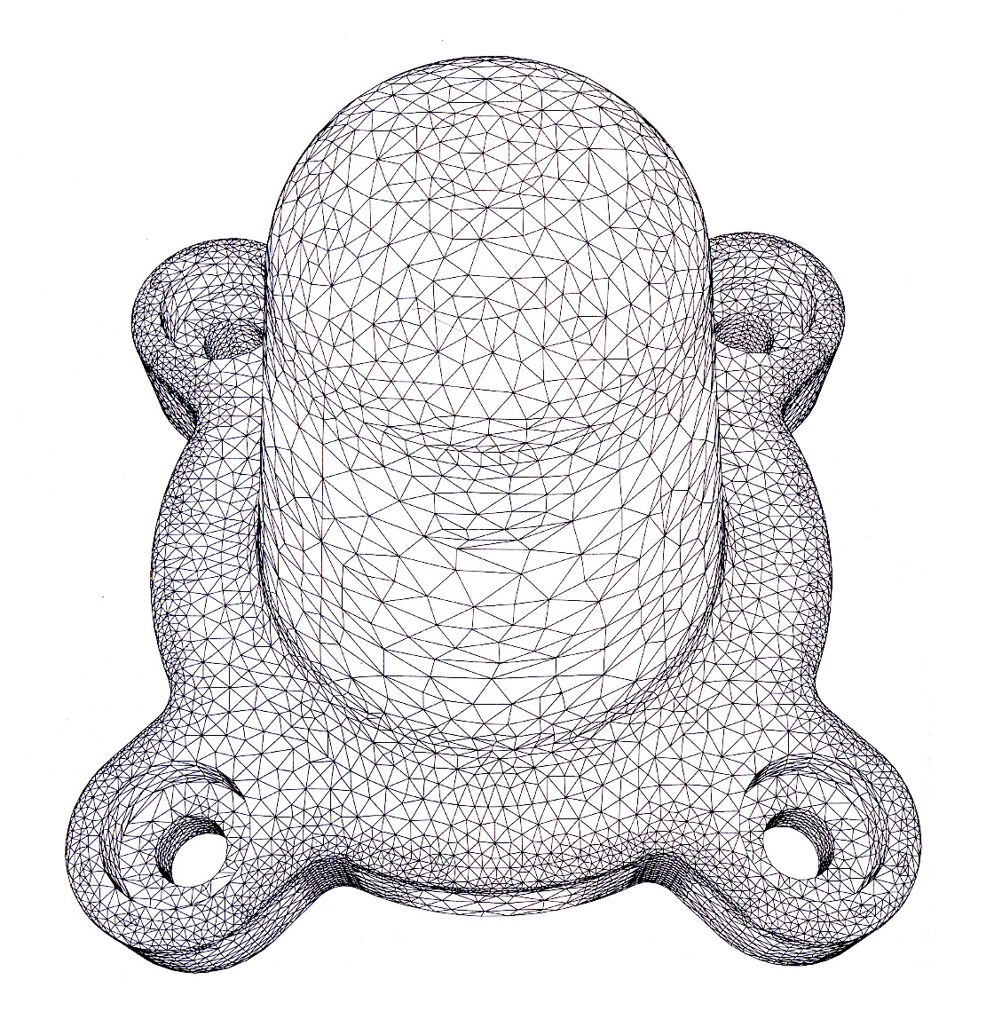
Irregular Mesh
Communication in non-predictable paths in mesh topology.
Hard to define due to varying
communication patterns.
Start point :
Pattern that constructed this mesh.
E. Kim

